Slide 1

Academic Writing –
Citation and Reference Tools

Slide 2
Agenda
Welcome
Citation Software
Online Solutions
Practice
Conclusion and Next Session
Estimated time: 20 – 25 min
Notes:
Here you can introduce the students to the topic of the presentation.
The aim is to give an overview of the available citation and reference tools, either online or via Leuphana's licenses.

Slide 3
Welcome
1.
Notes:
This is a blank slide that you can use to do an introductory activating activity with your group (if you start the session with this presentation).

Slide 4




Citation Software

Slide 5

Why Citation Software?
Avoid mistakes when citing
Save time when creating the bibliography
Allows you to reuse literature
You can find a comparison of the most commonly used software here.

Slide 6
Which Software should I use?
Zotero
  Free, simple
  Windows, Mac, Linux
  Also works with Google Docs
Citavi
  Leuphana license
  More extensive functions (knowledge management),
  but more complicated
  Windows only (there is an online version with
  limited functions for other platforms)
A Step-by-Step guiade for installing and using Zotero can be found here!
Notes:
Point out to the students that there are more programs (Mendeley...)
Mac and Linus users can theoretically use Citavi online, but you should advise against this, because without the Word add-in it is not so useful

Slide 7
Functions and Extras
Web-Picker: imports the bibliographic data directly from the browser (Zotero & Citavi)
Word Add-In: Makes it easier to insert citations into your paper (Zotero & Citavi)
Google Docs Add-In: Makes it easier to insert citations into a shared document (Zotero only)
Notes:
Please demonstrate what the web picker and the Word/Google Docs integration looks like so that students can visualize it better

Slide 8
Further Ressources
The Leuphana library offers information and training on various reference management programs, an overview can be found here.
For both Zotero and Citavi there are many instructions and help online
Zotero Forum
Citavi YouTube channel

Slide 9
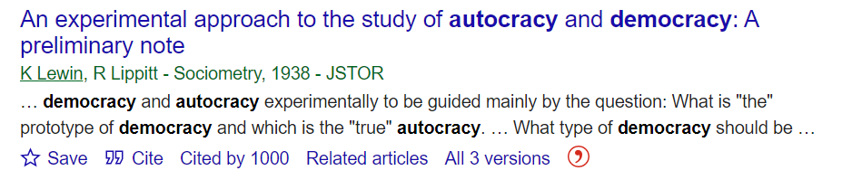
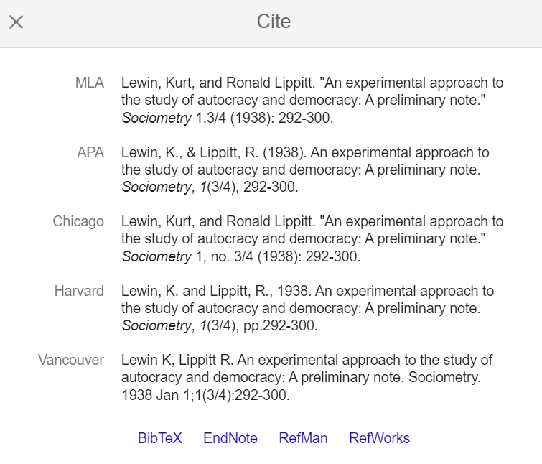

Online Solutions
2.1 Google Scholar
Google scholar can provide you with commonly used citation styles such as MLA, APA, Chicago, Harvard, and Vancouver.
This citation function includes links for exporting the citation data as BibTeX or RIS files supported by reference manager software.
To access the citation options, click on the quotation mark - Cite.
9
Notes:
The first online citation solution we would like to introduce is Google Scholar.
Google Scholar is not only a search tool for scientific articles and other publications, but you can also use Google Scholar to easily retrieve the reference of the article or book in different citation styles.
It is also possible to export such a reference to another citation management software.
Suggestion: Offer to present the online tool in the meeting.

Slide 10
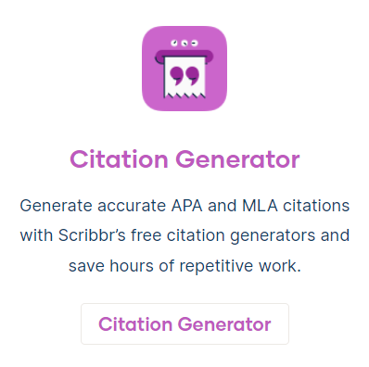
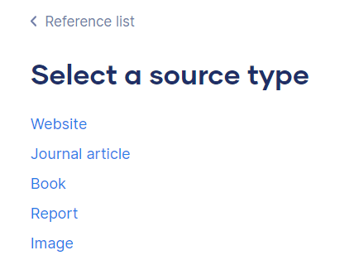
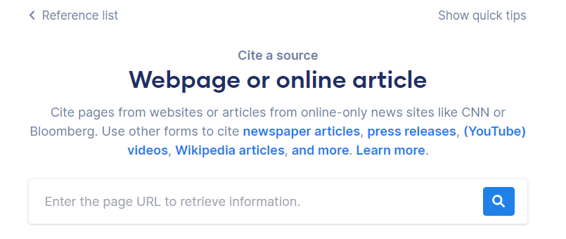
Online Solutions
2.2 Scribbr
The website Scribbr has a free online citation generator. You can generate citations from different sources, such as academic papers, websites, books, movie or documentary etc.
APA and MLA style.
You can choose between in-text citation or full reference.
You can access Scribbr citation generator here.
Images source: https://www.scribbr.com/
10
Notes:
The second online tool we introduced here is Scribbr.
In addition to the various texts that Scribbr offers for academic writing, the website also has its own citation and reference generator. It is very easy and intuitive to use.
Highly recommended for sources that you don't know how to cite or reference in a paper (e.g. a PowerPoint presentation in a lecture).
Suggestion: Offer to present the online tool in the session.

Slide 11
Practice
Notes:
Tutors are encouraged to show some of the features of the citation programs they use (if they use any) and give valuable tips to students.

Slide 12
Conclusion and Next Session
Notes:
Here you can conclude the session or, if you wish, summarize the main points.
If this is the last presentation in the session, this slide can be used as a preview of the next session topic.

Slide 13
Any Questions?
Notes:
This is the moment when you can ask them if they have any final questions about the topic of the presentation.

